Slide 1
Security Technologies
Privacy Enhancing Technologies
Leonardo A. Martucci

Slide 2
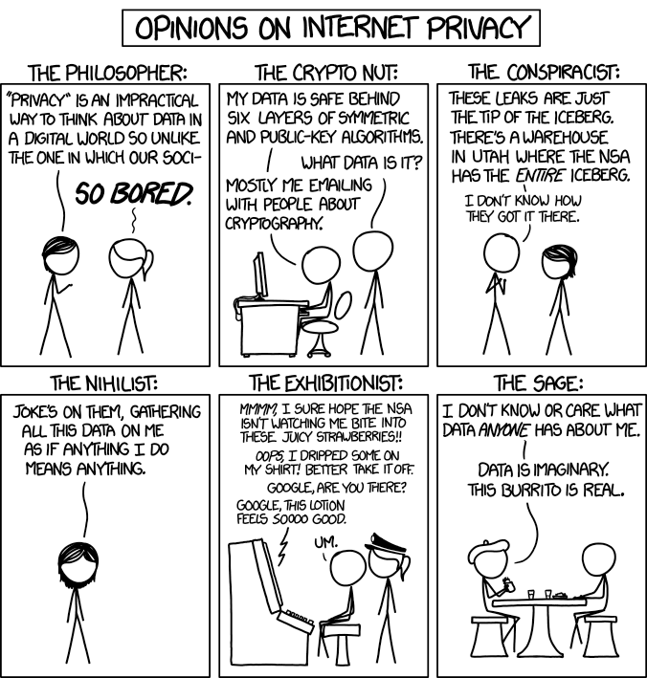
https://www.xkcd.com/1269/

Slide 3
Security Technologies
Have Objectives:
Confidentiality
Integrity
Availability
Authentication
Authorization
Accounting
https://www.xkcd.com/1269/

Slide 4
Technical Means for Securing Data
Data Security
Confidentiality, Integrity, Availability
Authentication, Authorization, Account
Implementing Data Protection
Control over Personal Data
Data Minimization / Avoidance
Identity Management
Lawful Processing of Data
recall from last session
requirement

Slide 5
Privacy Enhancing Technologies
Have Objectives:
Control over Personal Data
Transparency
Data Minimization / Avoidance
Identity Management
Lawful Processing of Data
Data Security and Integrity
https://www.xkcd.com/1269/

Slide 6
Confidentiality
Information NOT available or disclosed to unauthorized parties
Stored Data
Data in Transit

Slide 7
Integrity
Information NOT modified by unauthorized parties or in an unauthorized manner
Unauthorized Parties
Unauthorized Manner

Slide 8
Availability
Information available when needed
Available
NOT Available

Slide 9
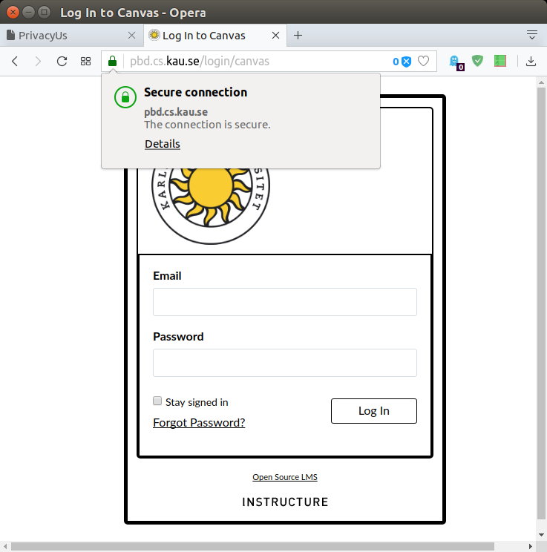
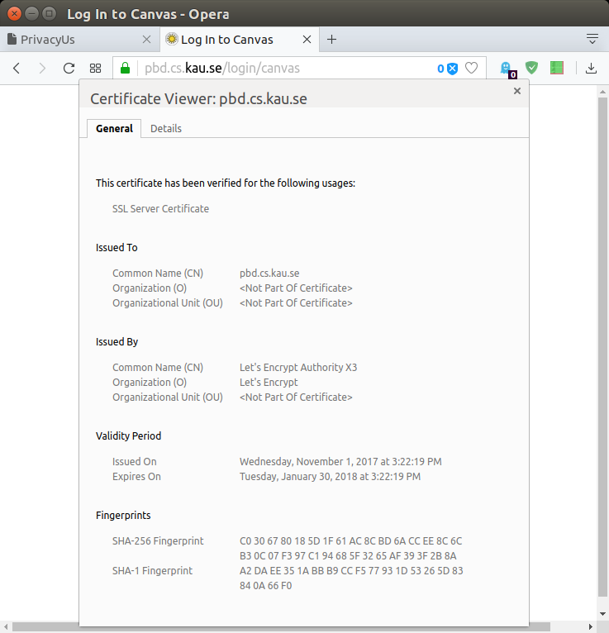
Authentication
Assurance of an identity claim
Are you really who you claim to be?
ID cards
Digital certificates
ID

Slide 10
Authorization
Grant or deny access to resources
operations over resources
(once authenticated)
Authorized
NOT Authorized
ID
read
write

Slide 11
Accounting
Keeping track of information
users and data
Building and storing log data
ID
# session

Slide 12
Part 1: Introduction
What are PETs?
Security technologies
Why we need technologies
Pfitzmann & Hansen terminology
next session

