Slide 1
Privacy Issues in Practice – Part II
Introduction to Privacy and the GDPR
Simone Fischer-Hübner
Notes:
In this lecture, we will continue to discuss privacy issues related to online social networks, big data and cloud computing.

Slide 2
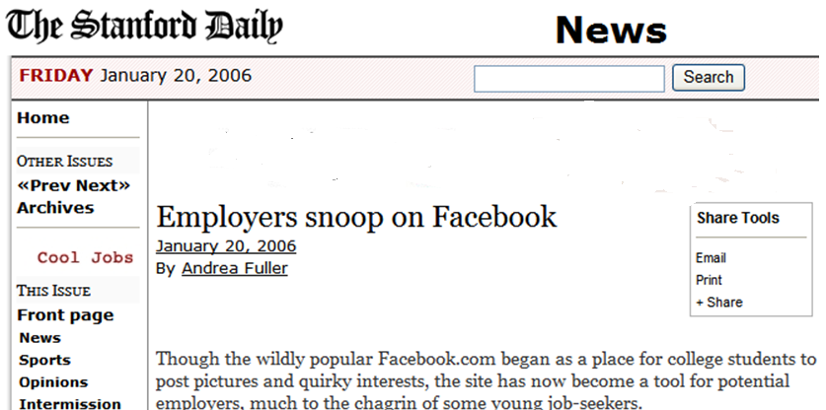
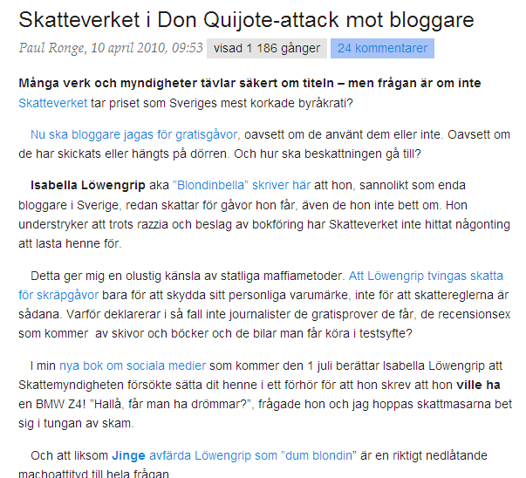
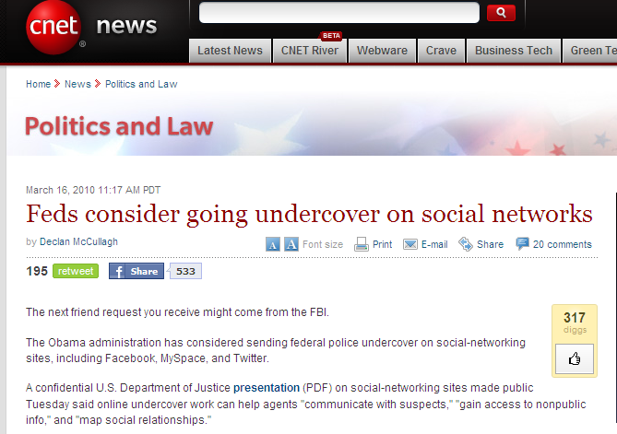
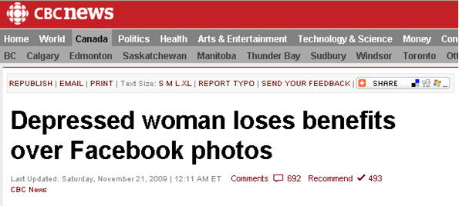
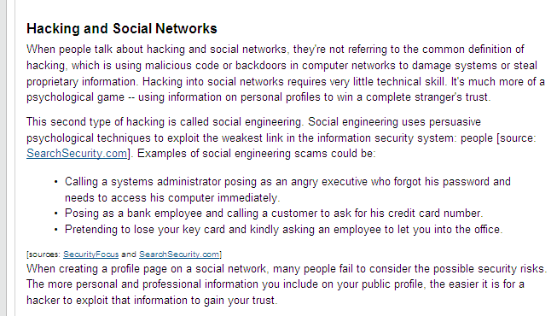
IV. Privacy Risks of Social Networks – Social Network Analysis
Social Network Analysis/Profiling by:
Employers
Schools/Universities
Tax authorities
Law Enforcement
Insurances
Hackers
…..
http://www.paulronge.se/skatteverket-i-don-quijote-attack-mot-bloggare
https://computer.howstuffworks.com/internet/social-networking/information/how-online-social-networks-work2.htm
Notes:
Online Social Network have much be discussed in terms of privacy. In Online Social network, users often publish very sensitive information that may be accessible for a broader audience. In this case, it may be hard to control for what purposes these data are later used and what information can be derived.
For many third parties, information derived from a social network analysis is used for purposes that the individual concerned may not be aware of or agree to.
For instance it has already for a longer time been discussed that employers like to snoop on Facebook for job candidates. Also Universities, such as Oxford University have checked social network sites for analyzing whether their students behaved properly and to find and fine trouble makers. Law enforcement checks participants behave suspiciously on social network site. In the context of Pre-Policing, this may even impact individuals that fall into a suspicious profile, without that they have ever done anything wrong. For instance, an older male social network user that chats much with teenagers may be suspected to be a potential child molester. Also tax authorities, such as Skatteverket like to check online market places for suspicious buyer or seller behavior, e.g. if people often sell imported cars without paying proper taxes for such kind of business, or if online avatars are sold without taxation. Insurances have also used social networks to check for potential insurance fraud cases. For instance, a Canadian woman that was on long-term sick leave because she was suffering from depression, got an insurance cut for photos that she published on Facebook during her vacation that she took to recover from her depression.
And finally, also hackers and criminals use to analyze social network sites for deriving personal information that can be used for targeted hacking and phishing attacks.
The question is whether the use of information that is openly published by an individual may be used for such purposes by other actors?

Slide 3
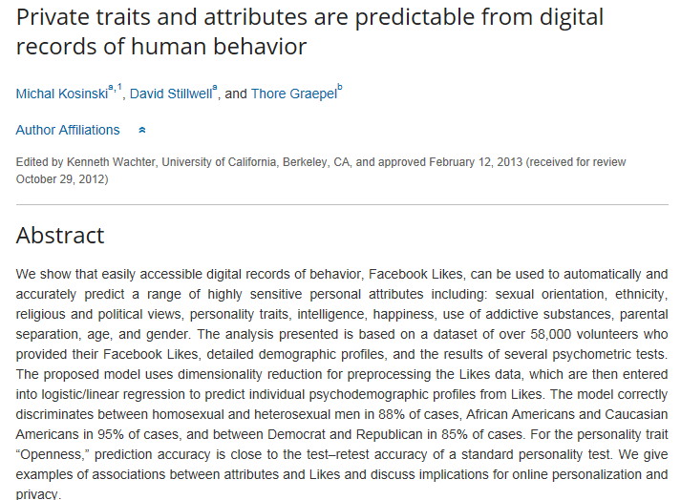
New types of derived data
Kosinski, M., Stillwell, D., & Graepel, T. (2013). Private traits and attributes are predictable from digital records of human behavior. Proceedings of the National Academy of Sciences, 110(15), 5802-5805.
Notes:
One may argue that information that is openly published may also be freely used.
However, the problem is that from the published data one could derive further data that is even more sensitive, without that the individual concerned will notice. These newly derived data can then processed without the awareness or consent of the individual concerned. As this type of data processing of newly derived data is intransparent and is not legitimized by a consent as a legal ground, it can be questioned whether this is legal.
Recent Research results from colleagues from Stanford University can illustrate this problem further:
They have found out and published in an article that the use of Facebook likes can predict highly sensitive personal attributes including: sexual orientation, ethnicity, religious and political views, personality traits, intelligence, happiness, use of addictive substances, parental separation, age, and gender.
This means that characteristics, such as intelligence or personality traits, could be found out that even individual concerned may not be aware of.
Imagine also that employers could for instance easily and secretly find out answers to questions that they would not be allowed to also during a job interview: for instance whether an applicant is pregnant, gay or lesbian.

Slide 4
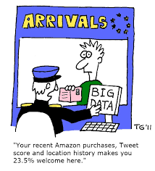
V. Privacy Risks & Challenges of Big Data
The sheer scale of data collection, tracking, profiling & detail of the data, from many different sources
Security of data
Transparency
Inaccuracy, discrimination, exclusion & economic imbalance
Increased possibilities of government surveillance
(Art. 29 WP - Opinion 03/2013 on purpose limitation)
Notes:
Related are privacy problems caused by the Analysis of Big Data with the help of Artificial Intelligence.
The Art. 29 Working Party, which means Representatives of European Data Protection Commissioners, has pointed that Big Data poses several privacy risks:
(*) The sheer scale of data collection, tracking, profiling & detail of the data, from many different sources – makes it difficult to guarantee the privacy principles of purpose binding or data minimisation; (*) Security of data is difficult to guarantee for such large data collections
(*) Big data analyses are often done in a for the data subject intransparent manner. (*) The results may lead to Inaccuracy, discrimination, exclusion & economic imbalance
(*) Finally, big data leads to increased possibilities of government surveillance, which is a serious issue as the Snowden revelation showed

Slide 5
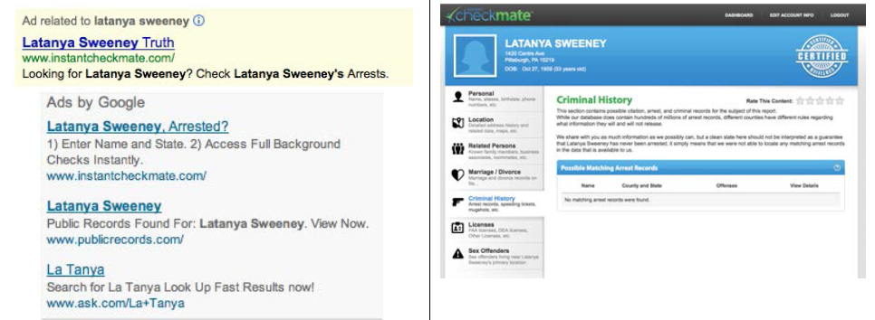
Personal Discrimination in Online Ad Delivery
Source: Latanya Sweeney, https://arxiv.org/abs/1301.6822
Notes:
The GDPR puts a stronger emphasis on fair and transparent data processing. However, there are many examples for discrimination of users by big data analyses with”intelligent” machine learning.
One case has been analysed and described by the American privacy professor Latanya Sweeney. She detected that Google Ads offering to check a person’s arrest record would be displayed with a greater likelihood if someone googles for a person with a typical ”Afro-American” first name, such as Ebony or Latanya than for persons with typical names for white Americans, such as Jill or Jane for example. These ads appear independently whether the related persons have committed any crimes or not. However, someone looking for a person and seeing such an ad may get a totally wrong negative impression from that person.
It was unclear whether this discriminating bias was programmed in Google algorithms or whether it was rather a result of the prejedicious behaviors of the Google users that were used as an input for training the algorithms. It can be assumed that rather the latter is the case, which means that the input data is already biased. This example shows how discrimination in the offline world is now being transferred to the online world by artificial intelligence.
Therefore in addition to algorithmic transparency also ethical data management is important.

Slide 6
Gender Discrimination
…..
Google’s online advertising system, for instance, showed an ad for high-income jobs to men much more often than it showed the ad to women, a new study by Carnegie Mellon University researchers found.
(JULY 9, 2015)
Notes:
There are similar examples for gender discrimination. For instance, Google’s online advertising system, showed an ad for high-income jobs to men much more often than it showed the ad to women, as a study by Carnegie Mellon University recently showed.

Slide 7
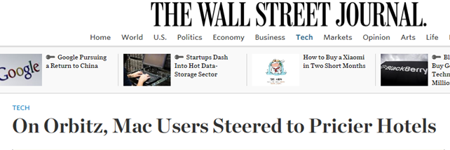
Price Discrimination
Notes:
Also price discrimination on the Internet has become a serious problem that is addressed by Konsumentverket in Sweden. It has for example been reported that with some online services Mac users get more pricy offers top-listed than Windows PC users.

Slide 8
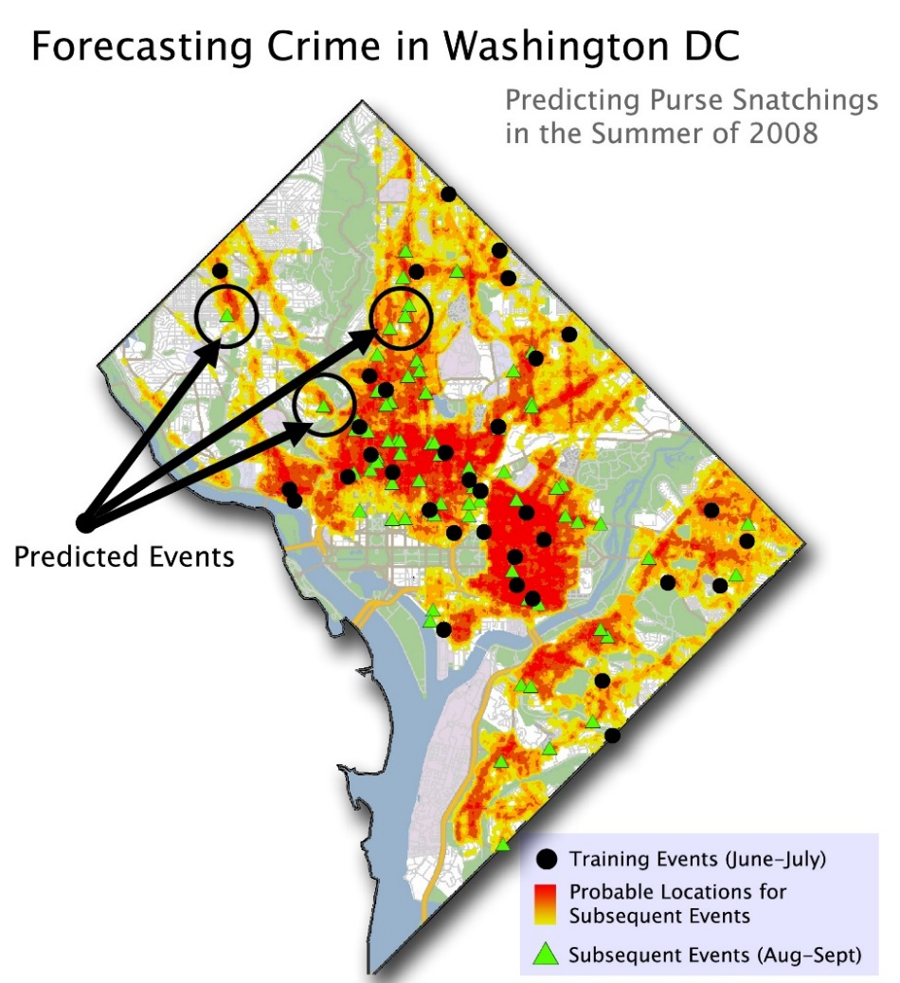
Predictive Policing
Notes:
Predictive Policing, or Pre-Policing, is another approach used by the police in the United States but also in European countries to predict potential crimes by big data analyses. User profiling in the context of pre-policing may however easily lead to discrimination. For instance the neighborhood is often taken as one of the indication for potential criminality – however, neighborhood may also correlate with predominant ethical groups living in this area.

Slide 9
VI. Lack of control related to Cloud Computing (Art. 29 WP Opinion 05/2012)
Lack of Transparency in regard to Cloud Service’s operations:
Chain with multiple processors & subcontractors
Different geographic locations within the EEA
Transfer to 3rd countries outside the EEA
Disclosure requests by law enforcement
Lack of Intervenability:
Lack of tools provided for exercising data subjects’ rights
CRM Sales Management - SaaS
Business Intelligence Database - PaaS
Storage Computation -- PaaS
Backup Computation
- PaaS
Picture after: Siani Pearson, NordSec 2014
Notes:
Finally, it is important to discuss also privacy issues related to cloud computing. Many users easily use services such as Google Docs, Google forms or Dropbox without having in mind or being aware of the fact that a cloud service is used, potentially with several further data processors involved as part of a cloud chain.
For instance, as shown in the figure on the left side, a user may use a CRM Sales System as a Software as a Service, which in turn uses a Business Intelligence Database as a Platform as a Service, which then uses Storage Computation and Backup Computation as Infrastructure as a Service.
As the Art. 29 Working Party representing the European Data Protection Commissioners pointed out, there is a lack of Transparency in regard to Cloud Service’s operations, in regard to
(*) the Chain with multiple processors & subcontractors involved
(*) Different geographic locations within the Europe
(*) Transfer to 3rd countries outside the Europe - which may have jurisdictions with a lower level of legal privacy protection than in Europe)
(*) and finally in regard to how easily the involved cloud service agree to disclosure requests by law enforcement – especially in context of the Snowden revelations, some cloud provider were criticized because they did not question the legitimacy of disclosure requests by the NSA and instead freely provided access.
Moreover, the Art. 29 WP also criticized that there a lack of tools provided for exercising data subjects’ rights to correct, delete data or to object to data processing.
In the following lectures, we will discuss how far the GDPR and the ePrivacy Regulation will address such issues. We will also discuss in the end what privacy issues are not sufficiently addressed by the GDPR and will still remain as challenges to be addressed in future.

