Slide 1
Basic Privacy Principles
Introduction to Privacy and the GDPR
Simone Fischer-Hübner
Notes:
Privacy is a basic human right and expression of human dignity and autonomy of individuals.
However it is not an absolute right, as it can also be in conflict with other values or other basic rights (such as freedom of the press, the Swedish openness principle, or freedom of research).
However, in order to protect the very core of privacy, certain basic privacy principles need to be followed if personal data are collected and processed.

Slide 2
Basic Privacy Principles (part of OECD Privacy Guidelines & most Privacy/Data Protection Laws)
Lawfullness of processing, e.g. by Informed Consent
(c.f. OECD Collection Limitation Principle)
Data Minimisation & Avoidance
(c.f. OECD Data Quality Principle)
Data should be adequate, relevant and not exessive
Minimisation of data collection, use, sharing, linkability, retention
Notes:
In the following, we will go through a list of the most essential privacy principles, which are internally well acknowledged and part of the OECD privacy guidelines and implemented by most privacy and data protection laws (including the GDPR):
First of all, data processing needs to be lawful – or as the OECD Collection Limitation Principle states: “There should be limits to the collection of personal data and any such data should be obtained by lawful and fair means and, where appropriate, with the knowledge or consent of the data subject.”
Dara minimization & Avoidance is a principle of key importance, because privacy can be best protected if no personal data is collected at all or if at least the amount of personal data is limited to the minimum necessary. Simply speaking: If no personal data are collected, then there is no privacy issue.
According to the principle of proportionality, data to be collected/processed should be adequate, relevant and not excessive.
Data minimization is important in all phases of data processing, which means that data collection, use and sharing should be minimized, as well as the linkage of data. Moreover, data should be deleted if they are not needed any longer for the purposes for that they were collected, which means that also the data retention time should be minimized.
Traditional Privacy enhancing Technologies enforce he legal principle of data minimization by providing anonymity, unlinkability or pseudonymity. Examples are anonymous communication or payment schemes.
An anonymous prepaid card is a simple example for a privacy-friendly payment scheme, which in contrast to credit cards does not allow the profiling of the user’s shopping behavior by the bank or the credit card company.

Slide 3
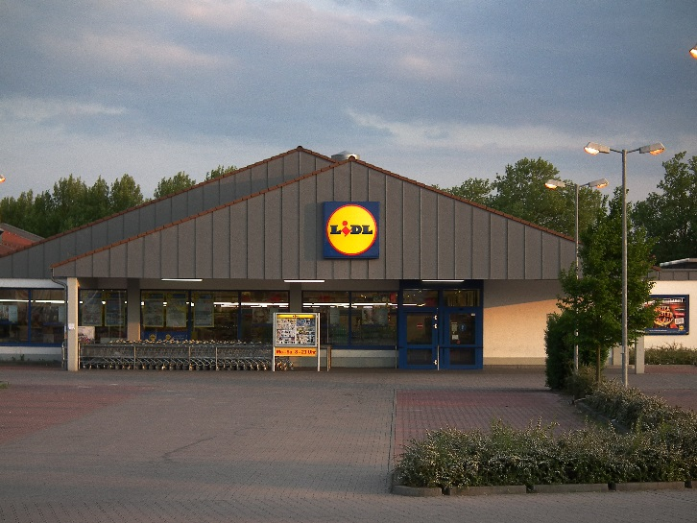
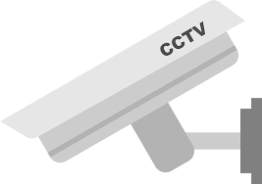
Basic Privacy Principles (II)
Purpose Specification & Purpose Binding
(c.f. OECD Purpose Specification Principle & Use Limitation Principle)
”Non-sensitive” data do not exist !
Examples of Purpose Misuse (”function creep”):
Lidl Video Monitoring Scandal (2006)
Loyality Card Data use against customer interests
Notes:
Another important privacy principle is the principle of purpose specification and purpose binding, which means that personal data should only be collected and later used for specified purposes.
This principle is important, because as the sensitivity of personal data is mainly influenced by its purpose and context of use. As the German Constitutional Court proclaimed in its Census Decision: There are no non-sensitive data (!), as dependent on the purpose and context of use all kinds of personal data can become sensitive.
Even though there is personal data that per se already contain sensitive information (e.g. medical data), dependent on the purpose and context of use, such sensitive data can become even more sensitive and data that seems to be non-sensitive (e.g. addresses) can become highly sensitive as well.
Therefore, if personal data are to be collected or processed, the purpose of data processing needs to be clearly specified and the subsequent use should be limited to the fulfilment of those purposes.
In practice, there are however many examples of purpose misuse or so-called “function creep”:
One example is the Video Monitoring Scandal by the Supermarket chain Lidl in Germany in 2006:
At that time, video surveillance cameras were installed over the cashiers with the official purpose to detect shop-lifting.
In reality, the cameras were however used to spy on the employees and to monitor their performance at the work place (as the German magazine “Stern” later revealed): Detectives were hired to evaluate the film material to check whether the Lidl employees were dressed appropriately, behaved well and to monitor how long breaks they were taking, e.g. For visiting the toilets, etc.
Other examples are instances where loyalty cards from supermarkets were used against customer interests:
Supermarket bonus cards allow to collect a lot of sensitive information about our shopping behaviour, for instance:
What kind of food we shop (healthy food, junk food, vegan food)
What kind or newspapers or magazine we buy.
One example of purpose misuse of such bonus cards was given by a Californian supermarket that tried to use its loyalty card records in a court case against a customer who slipped and was injured in the store. The supermarket believed the customer was under the influence of alcohol at the time and wanted to use its purchase data to support the claim that the customer use to buy a lot of alcohol and was thus probably an alcoholic. (However, this evidence was ultimately never used in court.)

Slide 4
Basic Privacy Principles (III)
Transparency and Intervenability
(c.f. OECD Openness Principle & Individual Participation Principle)
Appropriate Security
(c.f. OECD Security Safeguards Principle)
Accountability
(c.f. OECD Accountability Principle)
Notes:
Transparency of data processing is a pre-condition for informational self-determination and for a fair data processing.
A society, in which individuals could not know any longer who, what and when, and in which situations knows about them, would be contradictory to the right of informational self-determination.
Therefore, data subjects should have extensive information and access rights.
Besides, individuals should also have the right to “intervene” the processing of their personal data when unjustified, and therefore have rights to request to delete or correct their data or to object to the processing or their data.
The principle of appropriate security means that personal data should be processed in a manner that ensures appropriate security of the personal data - confidentiality, integrity and availability of data need to be protected.
Finally, the Accountability Principle requires that:
A data controller should be accountable for complying with measures for implementing these basic privacy principles just mentioned.
Independent data protection commissioners are usually in place for monitoring compliance and acting upon complaints of data subjects.

